Slide 1
A RefResher in Laboratory Statistics: Using R in Validations and Verifications
Amrom Obstfeld
November 22, 2024

Slide 2
Lesson Goals
Get oriented to R and RStudio
Learn some fundamentals of coding
Lesson Objectives
Log in and tour RStudio Cloud
Execute code at the console
Define and use functions
Define and create objects in the environment
Load data into R and interact with a dataframe
Notes:
In this first session our goal is to develop some familiarity with the R programming language as well as some basic proficiency with coding fundamentals as they are implemented in R.
We will log into the R environment and learn about the how to execute code in the console.
Upon this we will layer concepts of functions and objects. We will use some basic functions and make some objects.
Finally we will load data and interact with a dataframe.

Slide 3
Getting Oriented to R

Slide 4



R
Programming language for
data analysis
RStudio
Interactive development environment (IDE)
R Markdown
Computational document format
Notes:
I’m sure you all are excited to get started programming and we will do that in just a few minutes.
Before we do that I want to introduce you to 3 items.
The first is R. R is a programming language for data analysis. There are lots of great things about R: it is freely available, great for wrangling data, and very capable for producing impressive visualizations. There is also a great community of folks using it for data science, and we are excited to welcome you all to the R community via this course.
(**) Then, there’s RStudio. RStudio is the name of a company and also the name of a piece of software this company makes (and makes available for free). You can think of RStudio as a sophisticated text editor for writing R code. You can run RStudio on Mac or Windows, or on a server.
(**) Finally there’s R Markdown. R Markdown is a computational document format that has executable code usually written in R. I say usually because it’s actually possible to write code in python, C++, and a other languages inside of an R Markdown document. R Markdown also includes capabilities for annotating your work which is incredibly handy.
These three R’s synergize for a robust ecosystem for performing data analysis.

Slide 5
R for Reproducible Data Analysis
Notes:
One of the most powerful aspects of working in the R environment is the ability to conduct reproducible data analyses (those analyses that can be shared, revised, repurposed and reproduced) by others.

Slide 6
Replication vs Reproduction
Replication: other people collect new data
Scientific gold standard
Difficult and time-consuming
Reproduction: other people analyze the same data
Does not by itself validate the analysis …
Has been proposed as a minimal standard
Notes:
Focus of learning the skills we’re teaching today isn’t strictly research
But we should define 2 terms frequently discussed in the research world: Replication and Reproduction.
Replication: other people collect new data and reach the same conclusions
This is the scientific gold standard but is also difficult and time-consuming.
Reproduction: other people analyze the same data and reach the same conclusions
Reproduction does *not* show by itself that the study is valid. There could still be problems with external validity of the conclusions, however, since it’s theoretically so much easier than going out there and doing an entirely new study, reproducibility has been proposed as a minimal standard to examine the scientific validity of the conclusions of a study.
And as the data analysis part of a study becomes more complex, reproducibility of the data analysis becomes more important.

Slide 7
Why YOU should analyze your data reproducibly
“Can we redo the analysis with this month’s data?”
“Why do the data in Table 1 not seem to agree with Figure 2?”
“Why did I decide to omit these six samples from my analysis?”
Your closest collaborator is You from 6 months ago
Notes:
But reproducibility doesn’t only help others. Consider the following 3 statements and ask yourself if they sound familiar.
-Can we redo the analysis with this month’s data?
-Why do the data in Table 1 not seem to agree with Figure 2?
-Why did I decide to omit these six samples from my analysis?
**Your closest collaborator is you from 6 months ago. You can do yourself a huge favor by using tools that promote reproducibility.
And if you are analyzing clinical data and might affect patient management or public health based on your findings, that makes it so much more important that you take steps to assure your analysis is documented, free of errors, and reproducible by others.

Slide 8
Getting Started with RStudio
Notes:
Without further ado, let’s dive in!!
Getting Started with RStudio.

Slide 9
Your Turn #1
Go to https://api-r.cloud in your browser and log in using the username and password provided in the course email.
Click “thumbs up” in zoom once you see the RStudio panes.
If you can’t access the site click “thumbs down” and we will set you up in a backup configuration shortly.
Notes:
Now it’s your turn to get logged into Rstudio.
Go to the site https://api-r.cloud in your browser.
Use the login credentials sent to you earlier (e.g. apir000 for login, 6 digit password).
If you don’t have your log in credentials, see the document we are posting in the chat.
Please click the yes button in zoom to let us know you logged in successfully.
We will do our best to get everyone logged in. If you are struggling to log in, please reach out in the chat and we will try to help you access the course content via an alternate method.
In a course this size, we may not be able to get every participant logged in successfully. If we aren’t able to help with your specific issue, don’t worry, follow along via the slides, the course will still be valuable for you.

Slide 10
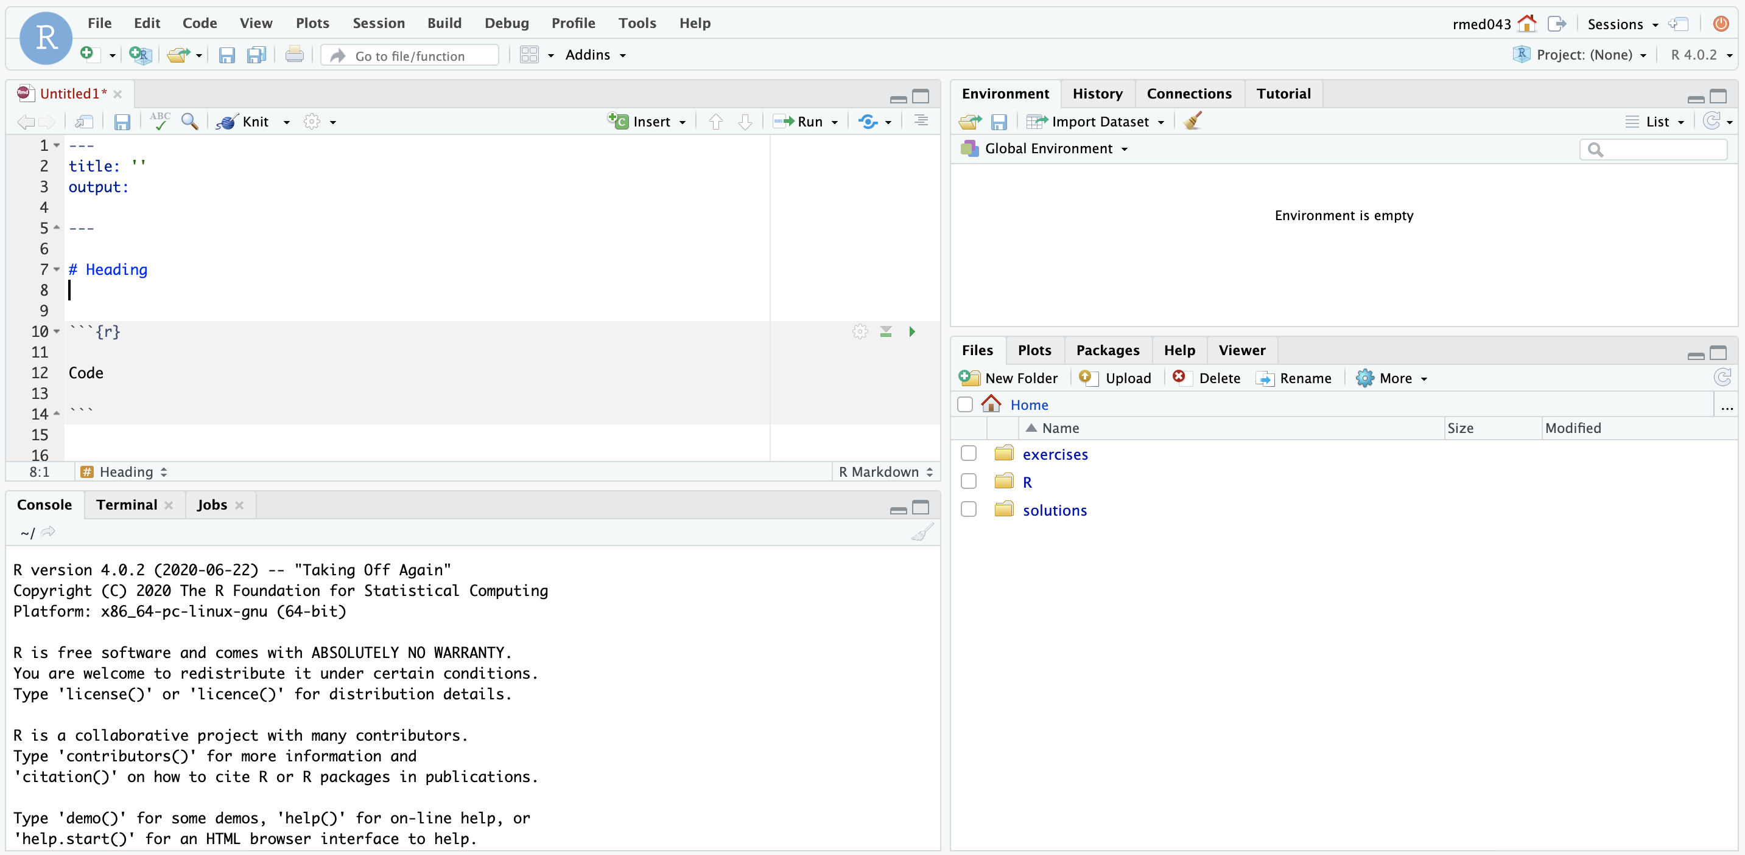
ENVIRONMENT
EDITOR
CONSOLE
MISC
Notes:
Here’s what the RStudio window looks like. Its separated into this quad window structure
On the top left is the editor. This is where you enter code. If you've just turned it on you won't see this open until you open a file.
On the top right is the Environment. The environment allows you to look at the data that’s loaded into R. Interacting with data in the environment tab provides some of the functionality you may be familiar with from working in Excel.
The Console is on the bottom left. You can use the console quickly run an individual R command, like install a package. We won’t use the console in this course.
The pane we have labeled “MISC” has a few of tabs. The most important one for today is the “Files” tab which shows the files we’ll be using for the course.

Slide 11
Notes:
R Markdown is a type of file that we most commonly use for writing R code. It provides us with features and tools to tackle the reproducibility problem.
The magic of R Markdown is that it allows us to craft a document composed of computer code mixed in with narrative annotation that in turn documents the purpose of the code. It allows us to note details and information about the decisions we made in our analysis.
R Markdown in other words provides us with a lab notebook interface for analysis, visualization, and annotation of our analytical work.

Slide 12
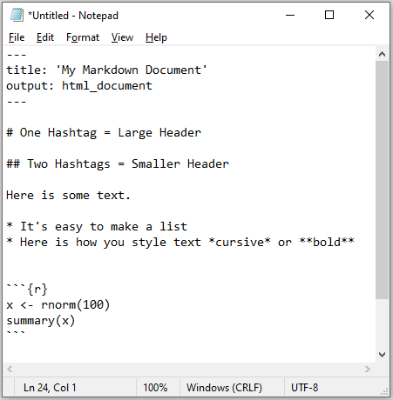
Anatomy of an R Markdown Document
Notes:
R Markdown documents are composed of 3 basic building blocks.
**The first is the Header which includes pieces like the name of the document, the document’s author, and the desired output format when the document is assembled.
**The second block is the text. R Markdown documents can be marked in ways that promote readability with various formatting styles.
**Finally, there are code chunks. Code chunks include include R code that can be executed to output results.

Slide 13
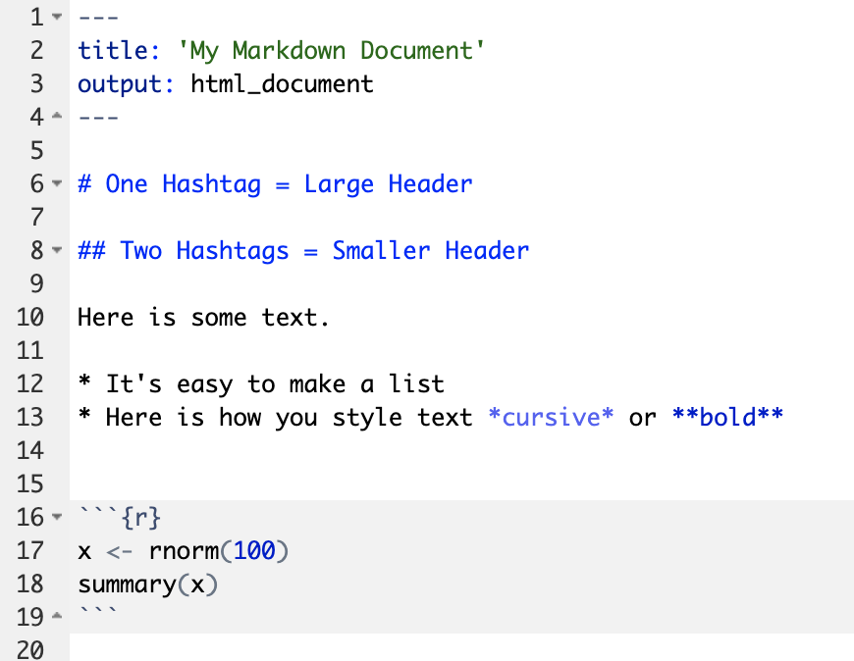
Anatomy of an R Markdown Document
Header
Header
Text (with marks)
Code chunk
Notes:
R Markdown documents are composed of 3 basic building blocks.
**The first is the Header which includes pieces like the name of the document, the document’s author, and the desired output format when the document is assembled.
**The second block is the text. R Markdown documents can be marked in ways that promote readability with various formatting styles.
**Finally, there are code chunks. Code chunks include include R code that can be executed to output results.

Slide 14
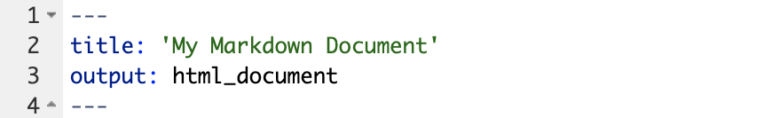
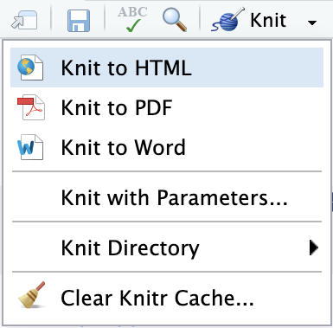
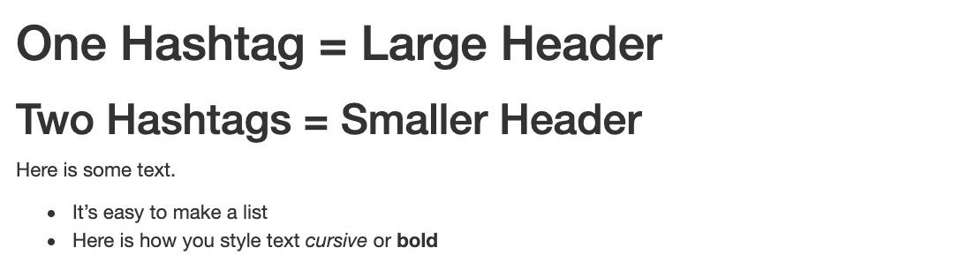
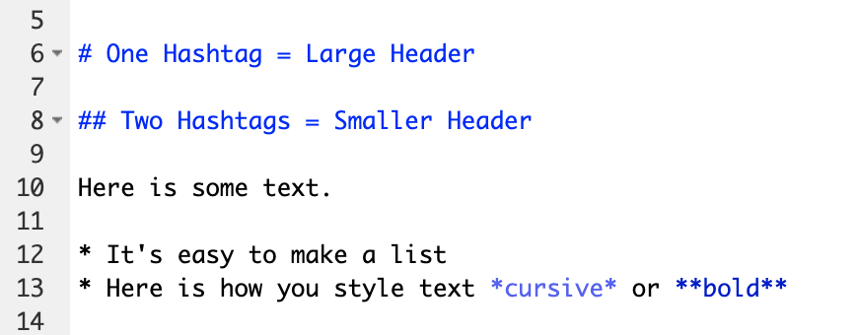
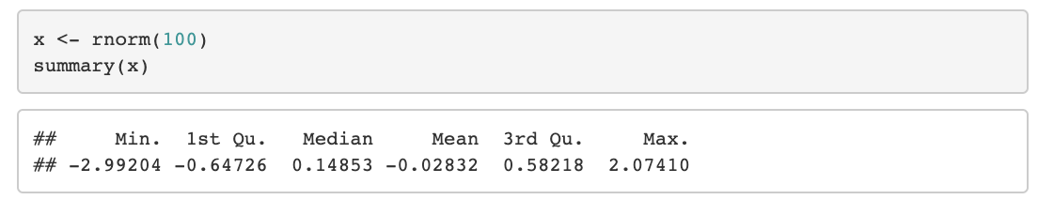
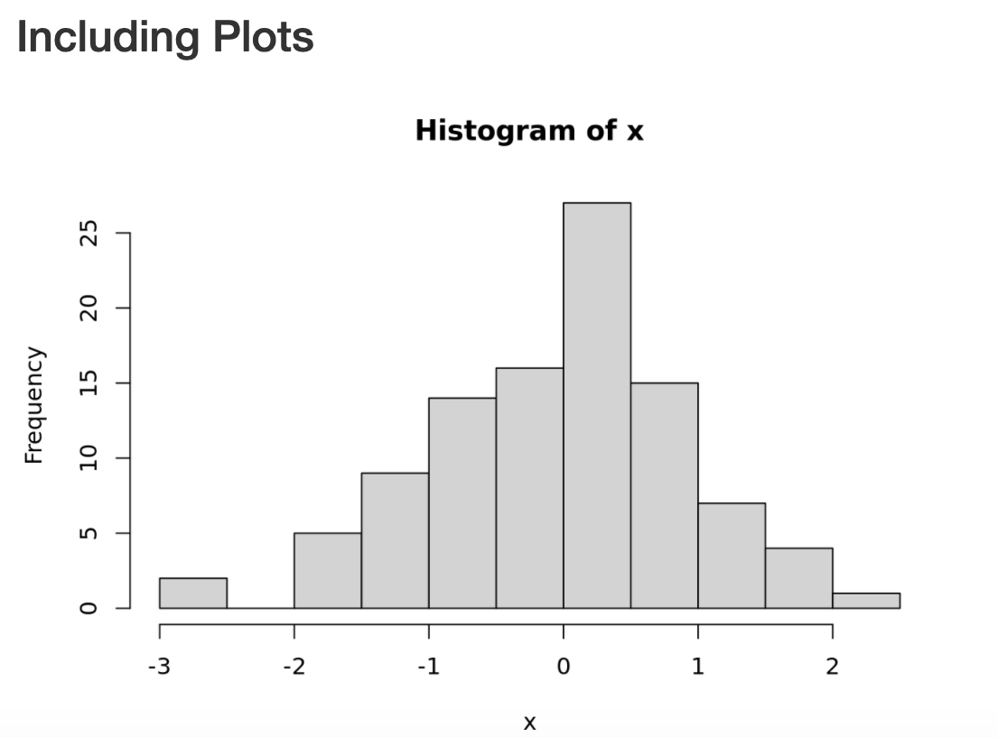
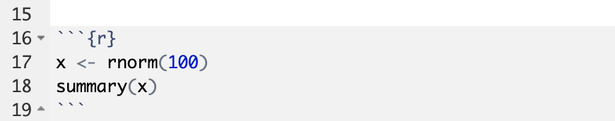
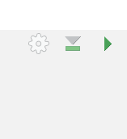
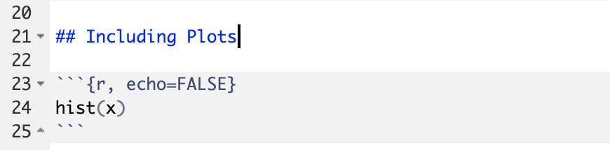
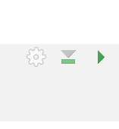
Notes:
Within the R Markdown document, we can execute a single code chunk by ** clicking the “Run Code Chunk” arrow.
And with the click of a button ** (called knitting), we can turn a R Markdown document from this ** to this.

Slide 15
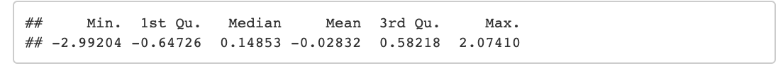
Notes:
Let’s look at this R Markdown document in greater detail.
Again the first block is header section
** The second block includes narrative text with styling applied.
** Then we get to the code chunks (shown in gray boxes). Don’t worry about the grammar of these particular code chunks at this point. In brief the first code chunk generates 100 normally distributed values which are performing a summary on. The knitted document shows us our code ** and the output of that code.
** The second code chunk renders a histogram visualization of that data.
The result is a neatly formatted document that includes an annotated description of our analysis, the code we used, and the output of that code.

Slide 16
Your Turn #2
Open a sample R Markdown document (File -> New File -> R Markdown).
Review the format of the document: header, text, code chunks
Execute the individual code chunks by selecting the Run Current Chunk arrow.
Knit the document to HTML (Preview or Knit Button -> Knit to HTML). You may be prompted to save your R Markdown first. In this case select a name for your document and click save. Review the knitted document.
Notes:
It’s your turn again.
Follow the instructions in Your Turn #2 to
-open an R Mardown document
-review the format
-execute individual code chunks
-knit the document
We will meet back in 3 minutes to review this exercise together.

Slide 17
The Basics of Coding

Slide 18
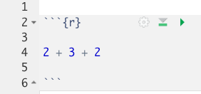
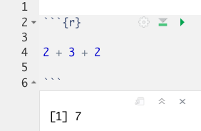

The Basics of Coding: Calculation
press play button to execute code
R is a calculator!
result returned here
Notes:
At it’s most basic, R is a fancy calculator.
It supports common mathematical operators
+ add, - subtract
* multiply, / divide
^ exponents
When we execute our code by pressing the play button, the answer is returned below the code chunk.

Slide 19
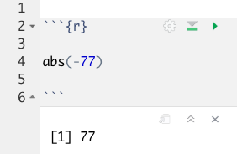
The Basics of Coding: Functions
Functions: Code that extends our reach beyond the basic operators
function
(does stuff)
argument
(input)
abs(-77)
Notes:
Functions are code that perform actions on our behalf. We can use functions that others have written (or that we write ourselves) to reuse existing code over and over.
→
Functions accept an argument (input). We use parentheses as the syntax (grammar) to identify the argument(s).
Then the function does its task and provides us with some output, in this case the absolute value of an integer.

Slide 20
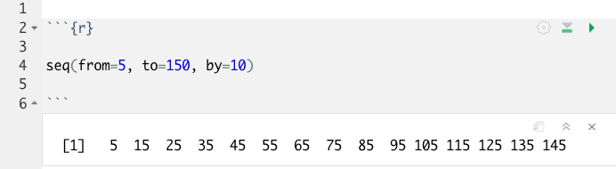
Putting Functions to Work
We can use functions to do more than simple math, we can make things!
We can create a series of integers (a vector) using the seq() function
Notes:
Functions can do more than simple math.
In this case the sequence function seq() accepts arguments defining a start position, a stop position, and an interval, to create a series (a vector) of integers.

Slide 21
The Basics of Coding: Objects
Objects: The container for your output
object
(stores output)
function
(does stuff)
arguments
(input)
sequence_of_10s <- seq(from=5, to=150, by=10 )
Notes:
Objects are a very important concept in many programming language.
Objects are the containers in which we can store things for later use.
You can store single values, series, tables, or even text.
In this example we are taking our previous seq() created series and storing it out to an object which we have called sequence_of_10s.
The <- characters are called an assignment operator. They point to the place where we want to store output.
You can execute code without assigning it to an object however the output is not stored for future use. If you want to revisit or reference the output of a particular line of code, assign it to an object using the assignment operator <-

Slide 22
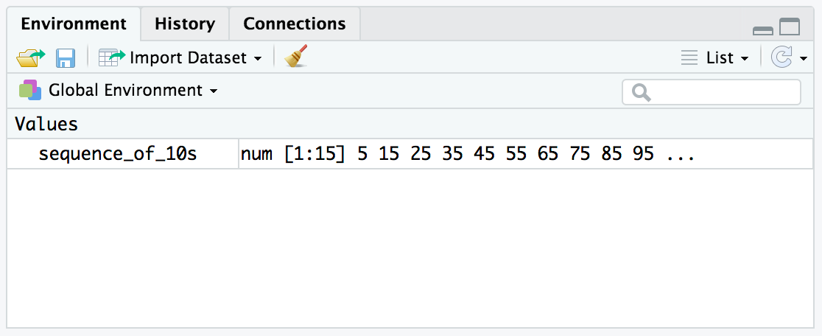
Checking the contents of an object
The environment tab shows us the objects we have created.
Notes:
We can also review our object in RStudio via the environment tab.
When we create an object in the environment, it will appear in the environment tab and we can review its contents there.

Slide 23
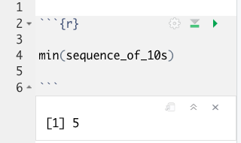
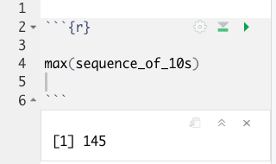
Bending objects to your will
Once we have created an object we can start to interact with it.
This includes passing our objects to other functions… Whoa!
Notes:
Objects are subject to same laws of programming we have learned so far.
We can provides objects as arguments for functions.

Slide 24
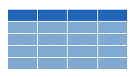


Dataframes: Beyond the Vector
Dataframe is the term for a table
Dataframes are composed:
Columns (Variables)
Rows (Observations)
Dataframes are objects and can be acted on like other objects
csv
xls
db
Notes:
Dataframe is the term we use for a table (think Excel spreadsheet).
Dataframes consists of columns (variables) and rows (observations). This is the tidy way to organize our data.
We can store dataframes as objects and perform actions on them like other objects.
We can get data into R from a variety of file formats (comma separated value files, excel spreadsheets, or directly from databases). This is the import part of data analysis.

Slide 25
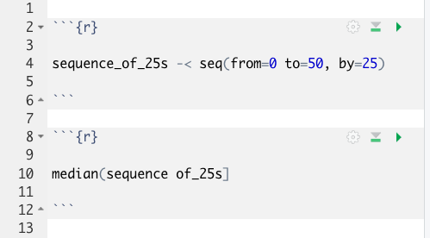
Your Turn #3
I’ve written some code to create a sequence from 0 to 500 in increments of 25 called sequence_of_25s. Ultimately I want to calculate the median value of this sequence. Unfortunately I’ve made some mistakes in my code and I am hoping you can help me find them.
Notes:
We will meet back together in a minute to see if we can fix this code together.

Slide 26
Tidyverse: R Packages for Data Science
A consistent way to organize data
Human readable, concise, consistent code
Build pipelines from atomic data analysis steps
Notes:
To import our CSV data, we need some additional data analysis tools. In this course, we will be leveraging the Tidyverse.
The Tidyverse is a modern set of tools for data analysis in R. It’s quickly becoming the de facto standard for doing data science with R.
The basic tenets of “tidy” data analysis include:
Data should be organized in a consistent, standardized way. Each row is an observation, and each column is a variable. This is a very common way to organize data in a spreadsheet and might sound familiar from how you may already organize data in tools like Excel.
Programming code that acts on the data should be consistent, concise, and mimic the narrative language as much as possible.
Each data analysis can be broken down into a series of atomic steps, such as “select this column” or ”arrange the data by the values in that column”. An arbitrarily complex data analysis can be broken down as a pipeline of atomic steps.

Slide 27
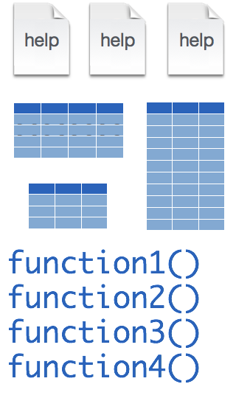
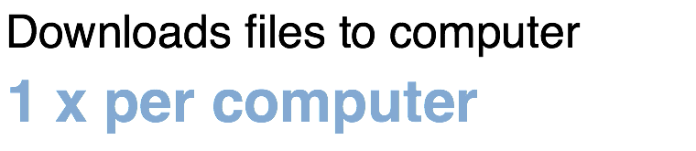
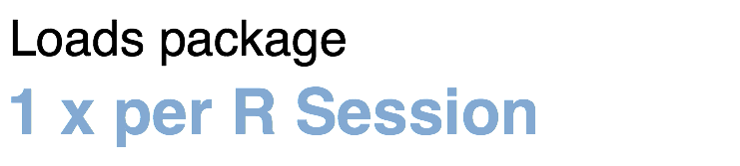
Installing and loading R packages
tidyverse
install.packages("tidyverse")
library("tidyverse")
Notes:
The Tidyverse is package (a collection of functions, data, and help documentation) that we can use to extend the functionality of R.
Packages need to be installed explicitly – with the command install.packages. So let’s say you want to install a package named “tidyverse”. You go to the R Console and type install.packages(“tidyverse”).
Each package you want to use needs to be installed only once on each computer. However, in order to use the functions or data in the package, you also need to load the package. This is done with the command “library”. So to enable all the functions in the “tidyverse” package, you type library(“tidyverse”). Packages remain loaded until you quit R. So every time you start a new R session you have to load each package that you want to use again.
On our RStudio Server, you won’t need to install any packages for this course (we have installed them for you). But at times in this course you’ll need to load packages.
So these are the first two R commands we’ve covered - install.packages and library.

Slide 28
Recap
Programming Language
Document Format
IDE
Packages extend the functionality of R. They need to be installed once per computer and loaded each session.
Functions do stuff. They accept Arguments to define parameters. We can store the output of functions in Objects using the assignment operator ( <- ).
Dataframes are the object types that store tabular data.
Notes:
To recap what we have covered in this introductory lesson.
We started by defining and differentiating R (the programming language) from Rstudio (the development environment) from R Markdown (the document format we use for reproducible data analysis).
In addition to learning to create and edit R Markdown documents we discussed some basic coding vocabulary including:
-Packages (such as the Tidyverse) which extend the functionality of R. We us the install.packages() function to install packages, and the library() function to load them into the environment.
-Functions do stuff on our behalf, they accept arguments, and we can store their output in named objects using the assignment operator
-Finally we discussed Dataframes which are the object types that store tabular data.

Slide 29
What else?
Notes:
At the end of each lesson we have included a what else section to introduce you to ”what else” you may want to explore and learn about after completing this course.
This includes helpful hints, other functions in the Tidyverse, and exciting packages you may want to check out.

Slide 30
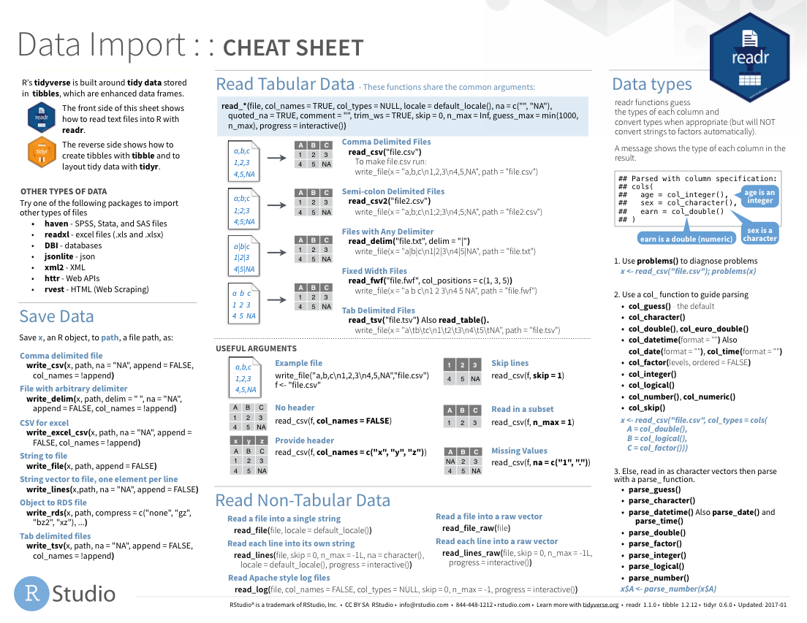
Notes:
The Data Import cheat sheet helps with the grammar of importing data including other file types and those with other separators (like pipes “|” instead of commas).
The Data Import cheat sheet is available on the RStudio website.

Slide 31
Notes:
There are a variety of other packages out there designed to deal with different file formats:
Readxl: Excel
Haven: SPSS, Stat, SAS files
Googlesheets
Rvest: scrape the web
Jsonlite: JSON data and APIs on the web

Slide 32
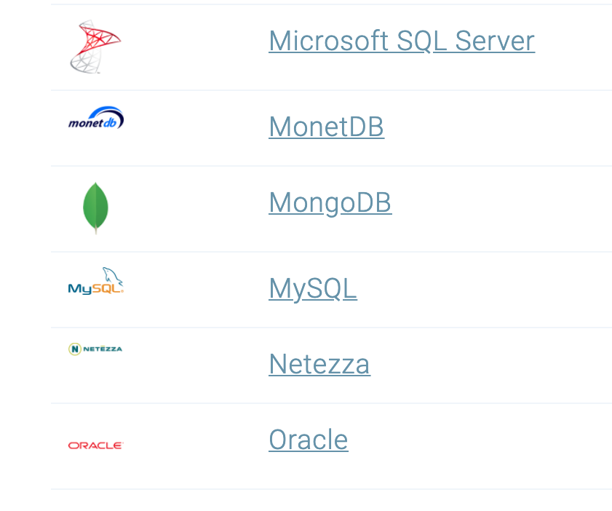
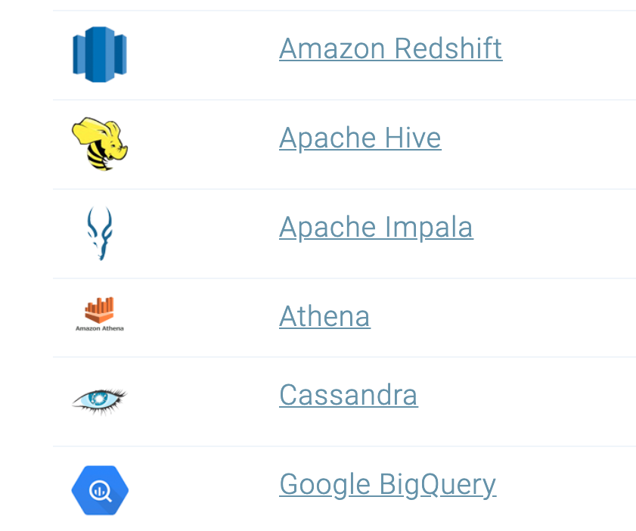
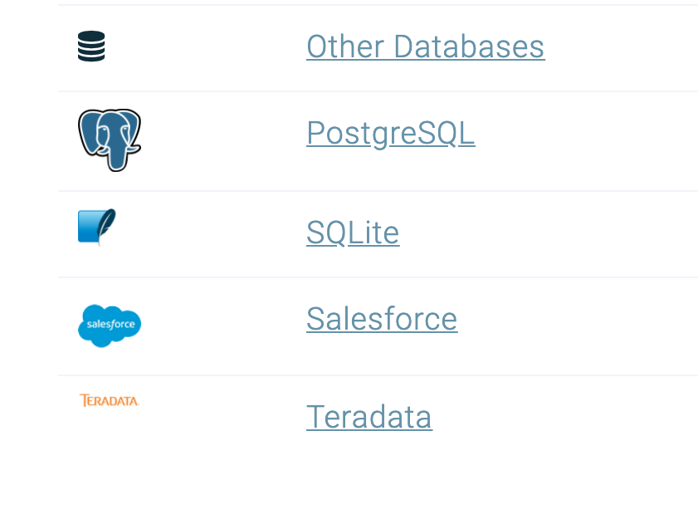
Databases
https://db.rstudio.com/databases/
Notes:
You can also connect to a variety of different databases directly in R to source your data.
If you use any of these, you may want to check out the tools to make database connections in R.

Slide 33





Notes:
In this lesson we practiced “knitting” our analysis to an HTML file.
In addition to HTML files, R Markdown documents can be “knitted” into a number of additional formats including PDF, Microsoft Word, PowerPoint, and even interactive dashboards. We will look at dashboards in greater detail later in the course.

Slide 34
R Interface to Python
```{python}
import pandas
covid_testing.info()
```
Notes:
The reticulate package provides an interface between R and python.
This means, you can mix code chunks written in R with code chunks written in Python.
R does many things really well, but no programming language is perfect for all tasks. It is great that R gives us tools to mix and match languages in different code chunks in situ.
For those of you new to coding, we recommend focusing on a single language to develop proficiency before moving on to another language. This will shorten the learning curve for your first and future languages.

